Slide 1
Welcome to the Xilinx Hackathon 2017

Slide 2

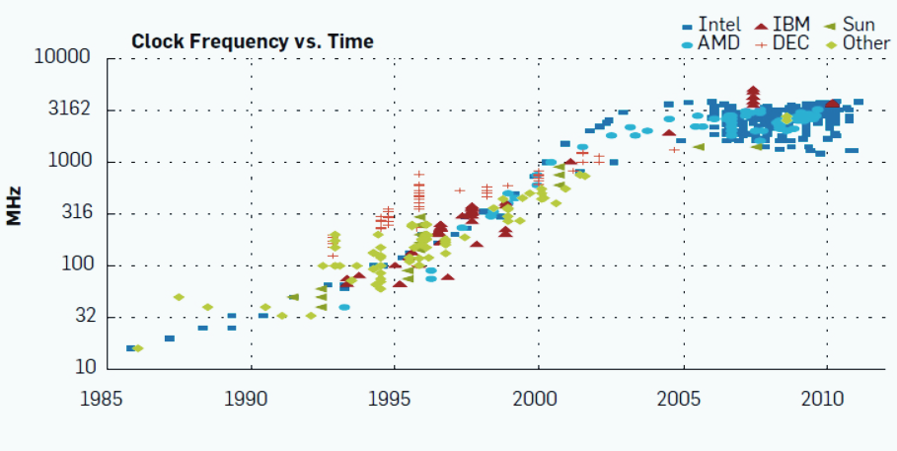

CPU Architectures not Scaling with Workloads Continued scaling requires accelerated computing, from Edge to Cloud
Processor frequency scaling ended in 2007
Multicore architecture scaling has flattened
Workload
Workloads require higher performance, lower latency
Cloud: video, big data, AI…
Edge: auto, surveillance, AI…
Andrew Danowitz, Kyle Kelley, James Mao, John P. Stevenson, Mark Horowitz Communications of the ACM, Vol. 55 No. 4
Notes:
As everyone here knows, processor frequencies scaling (Dennard scaling) ended about a decade ago. This was caused by excessive current leakage at small sizes, catching up with power constraints.
Multi-core CPU Architecture have flourished since, but they’re no longer scaling either, because they hit the same power constraints. Also, multi-threaded SW does not scale passed a few core.
Workload demand on the other hand, is still growing exponentially, both at the Edge and in the Cloud, and many applications require both higher compute performance and lower-latency, e.g.:
video transcoding of live video in the cloud Cloud
Autonomous Driving at the Edge
To handle this kind of workloads, heterogeneous compute architectures are needed: processors need to offload the compute intensive part to application specific accelerators that can provide performance and low latency.

Slide 3
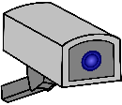




Workloads Move from Edge to Cloud… and Back Reconfigurable accelerators also needed at the edge
Cloud Computing
Edge Computing
Applications are moving to the Cloud:
centralized, elastic resources…
Applications are moving to the Edge:
preprocessing, lower network transfer
Notes:
But this trend is also valid for Edge devices
Many appliances like set-top boxes are moving to the cloud for better scalability and lower cost
But other applications are going in the other direction from Cloud to Edge
E.g.: surveillance cameras stream live video 24/7 for Cloud processing & storage. Now, with ML technology, the intelligence is moving back to the camera for pre-processing, so that only clips containing certain type of activities need to be streamed to the Cloud.
Also cars require live edge processing because who wants to count on a reliable network connection for collision avoidance?
In order to support diverse workloads like these, you need reconfigurable architectures for the Cloud as well as the Edge.

Slide 4
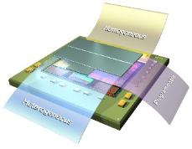
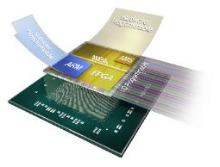
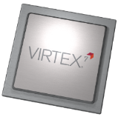



Charting an Aggressive Course Forward
3D IC
SoC
Surpassing Moore’s Law
Unprecedented Capacity & Performance
Programmable Systems Integration
FPGA
System Intelligence & Integration
Silicon + Architecture for Price/Performance/Watt
Break Out
Tools
Architecture
7 Series
UltraScale™ Architecture
Process
28HPL
20SoC
16FinFET+
7nm
Notes:
Presenter Note:
This is a standard slide we try to put at the front-end of all of our presentations now because it lays the foundation of Xilinx’s approach. You’re free to bring it back to SoCs but it’s relevant whether we’re talking FPGAs, SoCs, or tools.
Slide Notes:
First we need to outline Xilinx’s approach to building all programmable platforms and how this has led to the Zynq portfolio.
Starting with our 7 series devices on the left - built at the 28nm technology node we began the journey to deliver beyond conventional FPGA logic, delivering our first all programmable SoC, namely Zynq-7000.
We’ve always acknowledged that to keep up with design complexity at both a software and hardware level its necessary to focus on silicon process selection, architectural innovation and tools collectively.
We pioneered the 28 HPL process with TSMC as the optimal silicon process for programmable devices… and we call this our break-out node, where we achieved a new level of price-performance-per watt. We’ve further refined this approach at 20 nm, 16nm and now look forward to 7nm with TMSC - the #1 service foundry in the world.
But we know that it’s not process alone that determines success, it’s what you do with it. So following the highly successful 7-series families we introduced what we call the industry’s first “ASIC-class architecture” @20nm with UltraScale. Now augmented with UltraScale+ FPGAs at 16nm and our Heterogenous Zynq UltraScale+ SoC.
We also introduced Vivado, a breakthrough design suite with ASIC-class capabilities for productivity and Quality-of-Results. Recognizing that the design complexity our customers are now dealing with goes beyond traditional FPGA design and implementation flows. So extending this productivity imperative by laying out design methodology guidelines with UltraFAST, and introduced high level flows such as HLS and now SDx for faster time to integration of both hardware and software.
All of this initially made possible our break-out move into all things programmable – beyond FPGAs, with all programmable SoCs for new levels of integration and intelligence and beyond monolithic die with 3D ICs for breakthrough levels of capacity and performance.

Slide 5
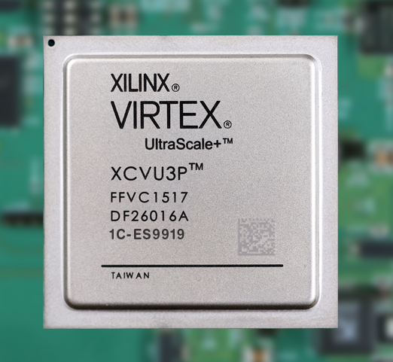
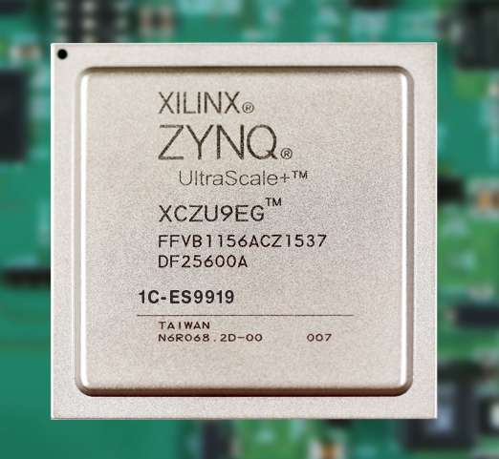
Emerging Solution: All Programmable Accelerators
Custom, accelerated processing
Reconfigurable to handle diverse workloads
Custom memory hierarchy
Avoid excessive DDR transfers
Custom IOs
Sensor Fusion at the edge
HDMI
Ethernet
Video decode
DNN
Video encode
Custom dataflow, memory, IO
Zynq® MPSoC
Virtex® FPGA
Notes:
And that’s where FPGAs and Zynq SoC come into play
With their programmable hardware and PS, they can be dynamically reconfigured as custom accelerators.
The main advantages of these devices are:
The ability to build a custom processing architecture with: custom dataflow, variable precision, bit shuffling, decision trees…
The ability to build a custom memory hierarchy which allows for streaming data from function to function without going to DDR
and at the edge, sensor fusion with custom IOs to accommodate a broad range of input signals for IoT
Clearly, the flexibility of FPGAs is a key advantage for scalable, customized acceleration.

Slide 6


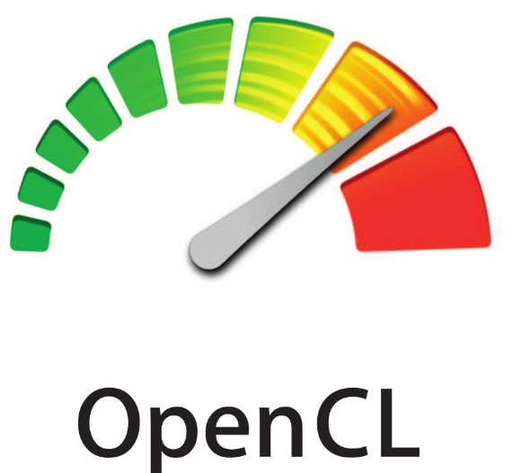
Harness the Flexibility of Programmable HW
HW engineers
Embedded SW developers
Application SW developers
Virtex® FPGA
Zynq® MPSoC
Notes:
But the challenge is how to harness this performance and flexibility for an increasingly diverse set of developers with HW or SW backgrounds.
As you’ll learn today: Xilinx is now providing a richer development stack, that has made it a lot easier to build custom accelerators for
HW engineers
embedded SW developers
and even Application SW developers
And that comes with a breakout… <animation>

Slide 7

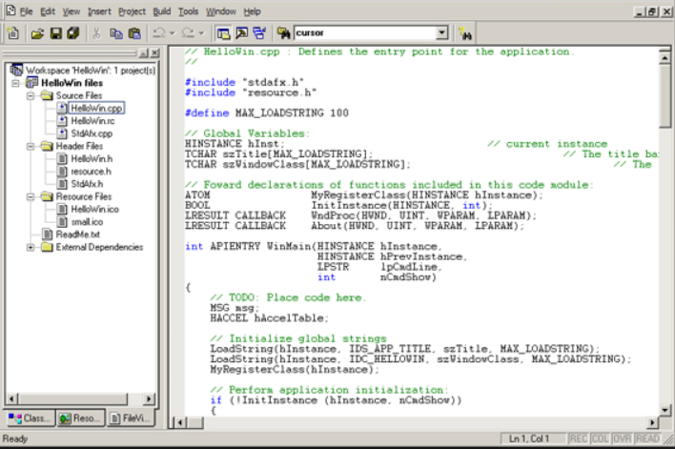



Breakout in Programming Model
Development
Productivity
SW Programmability
Ethernet
IP
Video decode
C++
Video
process
C++
Video encode
C++
HDMI
IP
15x productivity with HLS, IPI
HDMI
video enc.
video proc.
Traditional HW design
Notes:
…a breakout in programming model!
This illustrates our tools rollout over the past ~5 years:
At the foundation: RTL programming with Vivado for HW design
Above that: HLx, which brings a 15x productivity to HW developers, with HLS & IPI. This is the first step towards SW programmability
Here, HW engineers can quickly write & verify functions in C++
Then connects them in IPI, along with the IO interfaces, in a P&P fashion
The rest of the flow goes though Vivado
To enable SW programmers, we have now released SDx which enables full SW programmability for the Edge & the Cloud, i.e.: SW developers can program an FPGA entirely in C/C++ or OpenCL, given a board and an IO I/F design (developed with HLx)
(optional) That said, HW designers can still develop their accelerators in RTL and make them C-callable to use them in the main SW program
And we didn’t stop here…

Slide 8





Xilinx Product Families: A Broad Portfolio
SoC Portfolio
Cost-Optimized → Mid-Range
Mid-Range → High-End
Zynq-7000
All Programmable SoC System Optimized for Power & Cost
All Programmable Heterogeneous MPSoC
Right Engines for the Right Tasks
FPGA & 3D IC Portfolio
Cost-Optimized
Mid-Range
High-End
Lowest Power & Cost
Price/Performance/Watt
Performance & Capacity
Notes:
Presenter Note:
This is another slide we are also standardizing on at the front end of our presentations. While the previous slide lays out the strategic direction, this one transitions to the specific family names, but abstracts away the nodes to simplify the story and convey a message of scalability at both the FPGA and SoC level. This is in the FPGA pitch as well but as I talk through it obviously I’m giving it more emphasis on the SoC.
Slide Notes:
So let’s take a closer look at the specific families that comprise these FPGA, 3D IC, and SoC solutions.
In 2011, we introduced the first all-programmable SoC with Zynq-7000 that merged a dual core processing system with FPGA fabric to create a hybrid homogenous SoC - where closely coupled programmable hardware could offer additional acceleration and processing. This was the first of its kind and has since evolved into something even more groundbreaking in the 16nm generation with Zynq UltraScale+ - our heterogeneous MPSoC.
For FPGAs, the Cost Optimized FPGA category is shared by the Artix family and Spartan portfolios. While Spartan-6 is the only 45nm family in this view, it continues to meet the capability needs for many cost-sensitive applications at the right price point, by far the industry leader in its class.
We pioneered the mid-range with the Kintex family, representing a unique price-performance-balance not seen before, and we’ve continued that for the subsequent two generations since then.
Virtex has been our high-end category for a long time, always representing the greatest performance and capacity for any given generation.
By way of reflection cost-optimized mid-range, and high-end are characteristics of the SoC portfolio as well. Zynq 7000 covers a range of performance and processing capabilities, while Zynq UltraScale+ extends or solution to high-end processing requirements.

Slide 9
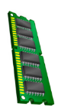



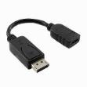

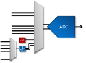
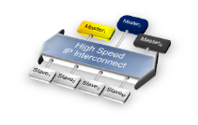
All Programmable SoC - Zynq®-7000
Zynq-7000S
Single-Core @ 766MHz
Artix-7 FPGA Fabric
Zynq-7000
Dual-Core @ 800MHz
Artix-7 FPGA Fabric
Zynq-7000
Dual-Core @ 1GHz
Kintex-7 FPGA Fabric
Processing System
Flash Controller
Memory Controller DDR3, DDR2, LPDDR2
SPI
AMBA
AMBA
High Bandwidth Memory
L1/L2 CPU Caches
Dedicated On-Chip Memory (OCM)
DDR3, DDR2, LPDDR2 w/ ECC
Application Processor
32-bit ARMv7
Up to 1GHz
I2C
CAN
MPCore
NEON SIMD & FPU
NEON™ SIMD & FPU
A9
NEON™ SIMD & FPU
ARM®
Cortex™-A9
ARM
Cortex-A9
UART
ARM®
Cortex™-A9
GPIO
Snoop Control Unit
Snoop Control Unit
SDIO
512KB L2 Cache
256KB OCM
USB
GIC
JTAG
Config
Timers
DMA
Integrated Memory Mapped Peripherals
USB2.0, GigE, CAN
UART, SDIO, I2C, SPI
FPGA Acceleration
7 Series FPGA Fabric
Customizable Engines
AMBA
AMBA
GigE
Security AES, SHA, RSA
Programmable Logic
6.25G Transceivers
ADC
PCIe Gen2
6.25G / 12.5G Transceivers
Tightly Coupled Domains
3000+ PS/PL interconnects
Up to 100Gb/s of bandwidth
Integrated Analog
Dual multi-channel 12-bit ADC
Temp & Voltage sensors
Extensive IP Portfolio
Standardized AXI4 interfaces
Enables peripheral expansion
Notes:
Presenter Note:
If your audience is familiar with Zynq-7000 you don’t have to go through all these points, but highlight that with the success of the family we decided to augment it with a “big brother” offering over 5X performance per watt, delivering a more capable set of processors, a broader range of peripherals, and even more interconnect bandwidth. Namely, Zynq UltraScale+.
Slide Notes:
[Click-1]
For those of you who aren’t familiar with Zynq-7000, the architecture leverages a dedicated processing system at the heart of which is an ARM Cortex A9 MPCore - with either a single or
[Click-2]
dual CPU implementation plus a custom 256KB of on-chip memory attached directly to the Snoop Control Unit.
Beyond this a critical part of the processing-subsystem is a selection of integrated peripherals:
[Click-3]
a tightly coupled, flexible high performance DDR controller with ECC support.
[Click-4]
SPI & I2C controllers for external component control, an array of memory controllers for Non Volatile memory access and USB 2.0 plus Gigabit Ethernet for common data interfacing.
[Click-5]
But what made Zynq a unique integration solution is the ability to merge a capable processor with flexible hardware technology, enabling the merging of CPU, DSP, ASSP, FPGA and mixed signal functionality on a single chip.
With over 3,000 interconnects between programmable FPGA technology and processor, you get low latency I/O bandwidth that’s simply impossible in a multi-chip solution. There just wouldn’t be enough pins to match this connectivity.
[Click-6]
But there’s no way to enable all this without a breadth of both embedded and hardware design tools and IP, plus an ecosystem of familiar OS solutions and run-time libraries.

Slide 10

Logistics
Hackathon Theme & Goals
Community Projects
Head back up to Retreat!
Welcome and
Orientation

Slide 11

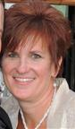
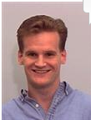

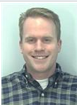
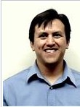

Organizers
Craig Abramson
Mindy Brooks
Derek Curd
Greg Daughtry
Brad Fross
Adrian Hernandez
Graham Schelle

Slide 12

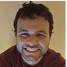


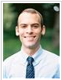
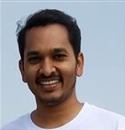

Helpers
We will be with you the full 30 hours (in shifts)!
Kv Thanjavur Bhaaskar
Anurag Dubey
Vikhyat Goyal
David Gronlund
Dustin Richmond
Naveen Purushotham
Rock Qu
Graham Schelle

Slide 13
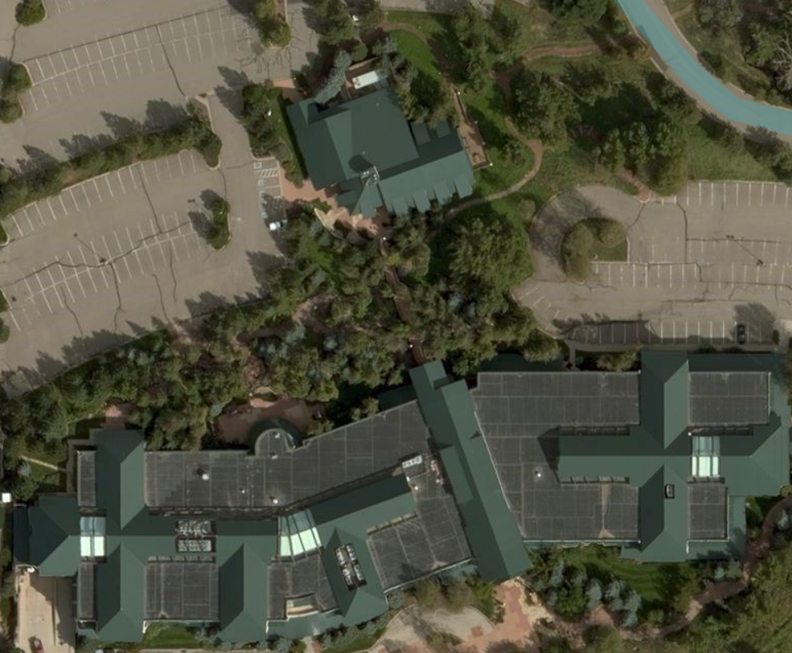
Logistics: Site Map
Summit Retreat
(Hackathon)
Silverthorn
(Orientation)

Slide 14
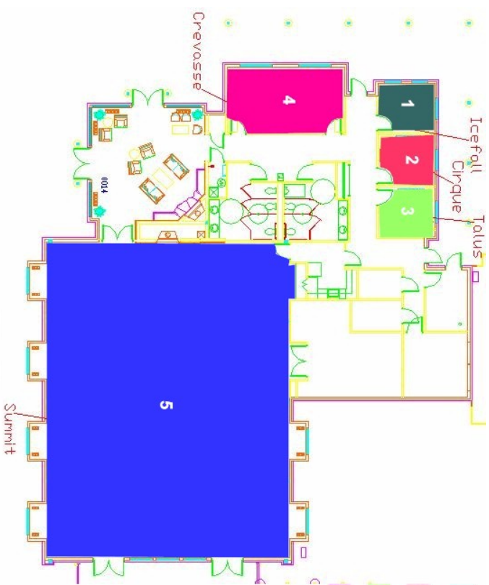
Logistics: Summit Retreat
Break
Break
Lobby
Break
Restrooms
Break
Hackathon
Kitchen

Slide 15
Logistics: Schedule
Friday:
5 PM – 7 PM Dinner & Orientation (Silverthorne)
7 PM – 8:30 PM PYNQ-Z1 Hand Out and Tutorials (Move to Summit Retreat)
11 PM - 12 AM (Recommended) Project Pitch and Feedback
Saturday:
12 AM – 4 AM Mini Challenge 1
8 AM – 9 AM Breakfast
9 AM – 1 PM Mini Challenge 2
12 PM – 1 PM Lunch
8 PM – 10 PM Dinner
9:30 PM Judging Starts
11:00 PM Awards
Drinks and Snacks will be available throughout the event

Slide 16
Hackathon Prizes
Category | Value
Best Design | $800
Runner Up | $400
Surprise Category | $100
Best Programmable Logic | $100
Mini Challenge 1 | Surprise Team Prize ($150 value)
Mini Challenge 2 | Surprise Team Prize ($150 value)
Saturday Night Non-Tech Challenge | $100
Everyone can keep their PYNQ-Z1 board!

Slide 17
Hackathon Judging Criteria
 | Score (0-10) | Criteria | Description
Idea | 10 | Creativity | How creative or innovative is the idea behind the design?
 | 10 | Viability | How relevant is the design's use case to a real problem?
Open Source and Reproducible | 10 | open-source | Are build steps provided, python packaged, and available on github as notebook and source code.
 | 10 | reproducible | Could someone reproduce this work starting from a pynq v2.0 image and going through their notebook
Implementation | 10 | Feasibility | Does it actually work?
 | 10 | Uniqueness | How well does the app leverage a variety of different open-source APIs and programmable logic

Slide 18
Code of Conduct
Be Respectful
Harassment and abuse are never tolerated
Participants asked to stop any harassing behavior are expected to comply immediately.
If you are being harassed, notice that someone else is being harassed, or have any other concerns, please contact Xilinx Hackathon organizers
Full Code of Conduct in Hackathon packets

Slide 19
WiFi & Internet Access
WiFi
Network securebrd
Password hackathon2017
Ethernet
No wall-plate connections
Bridge network from laptop to PYNQ-Z1

Slide 20
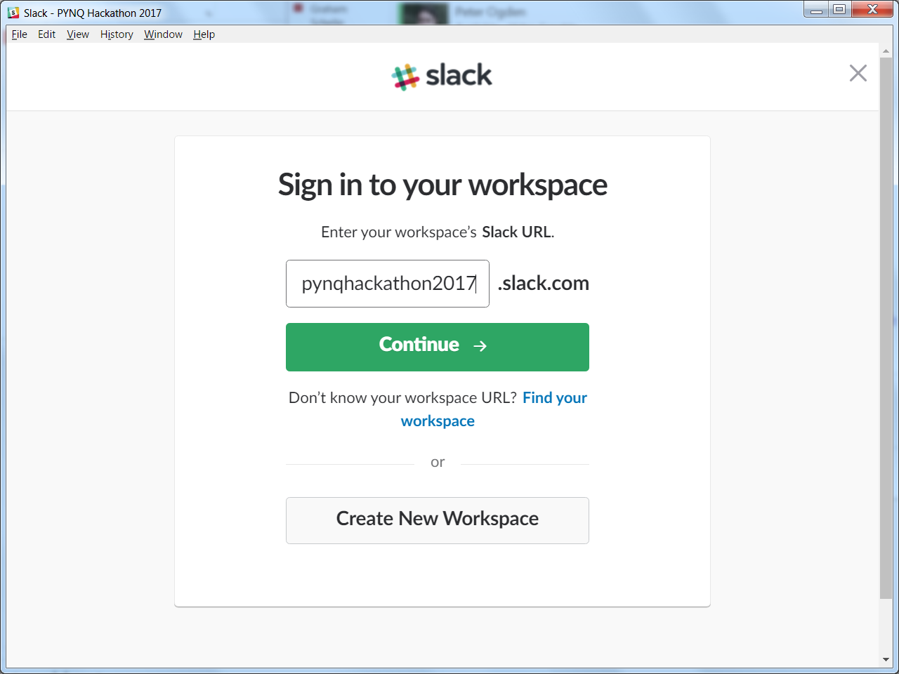
Collaboration
GitHub
PYNQ Repositories
http://github.com/xilinx/PYNQ
https://github.com/drichmond/PYNQ-Hackathon-2017
Slack

Slide 21
Logistics
Hackathon Theme & Goals
Community Projects
Head back up to Retreat!
Welcome and
Orientation

Slide 22
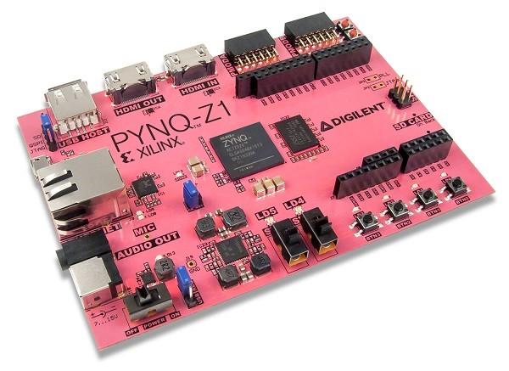


Hackathon Themes
Build something cool
Contribute to Open Source
Contribute Reproducible Results

Slide 23
PYNQ-Z1 Board
Zynq XC7Z020 CLG400
512 MB DRAM
HDMI input, HDMI out
Microphone input
Audio output
10/100/1G Ethernet
MicroSD slot
USB 2.0
4 LEDs, 4 buttons, 2 switches
Arduino connector
With additional IO
2 Pmod 8-pin GPIOs

Slide 24
PYNQ-Z1 Board
Software Preloaded
Ubuntu
Python 3.6
WiFi Connectivity
Extend it
Apt-get, pip install, git clone
Crash it
We’ll burn a new SDCard
Programmable Logic Designs Preloaded
Soft Processors on Arduino & PMOD
Real-time Video Pipeline, Audio
Neural Networks
LogicTools – programmable waveforms
25+ example notebooks

Slide 25
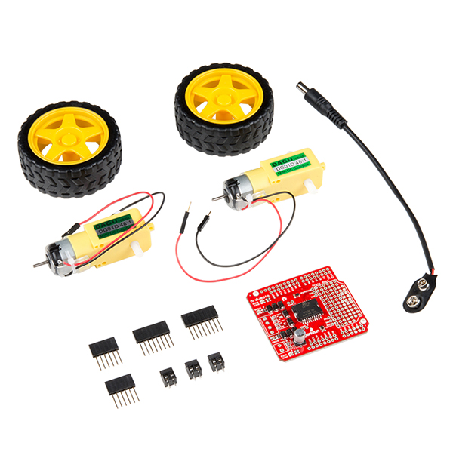
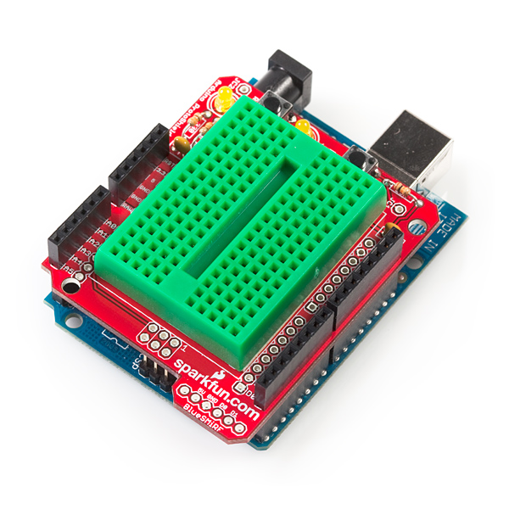
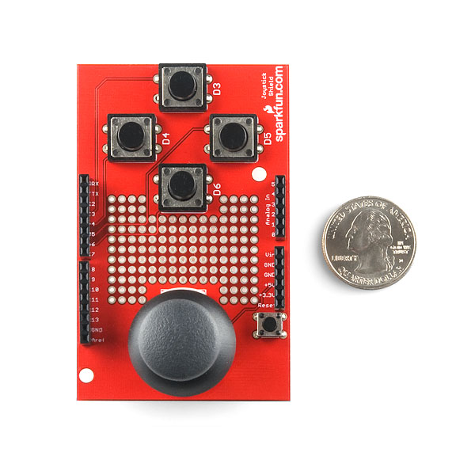
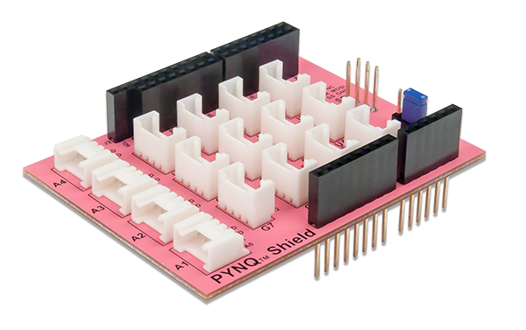
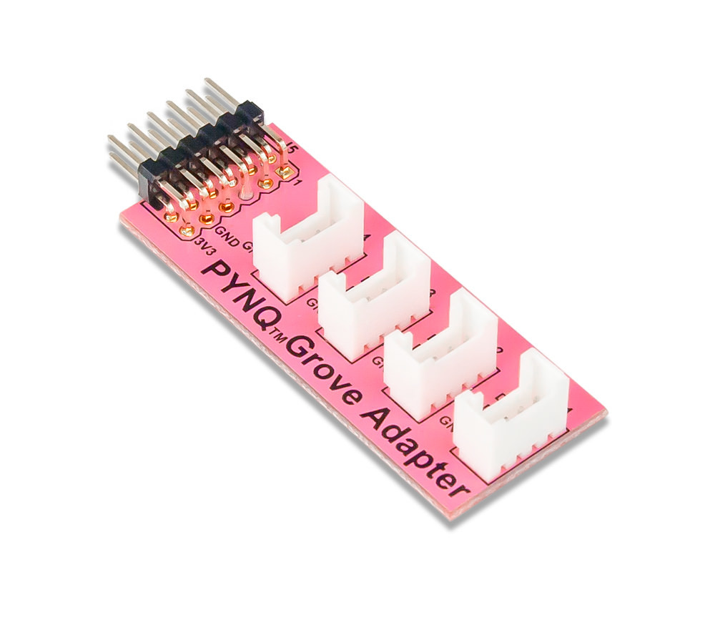
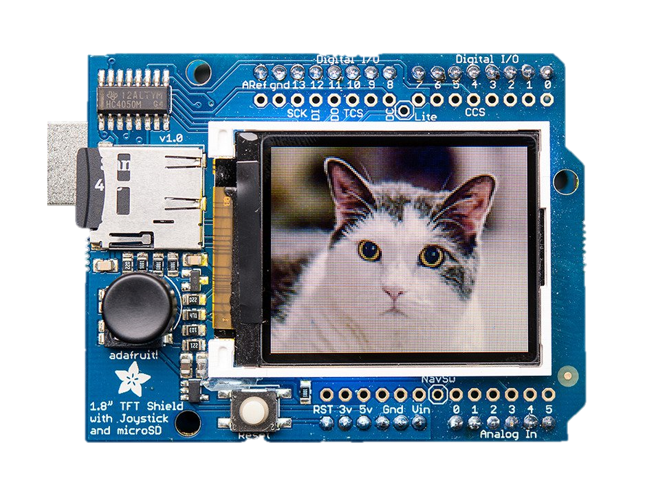
PYNQ Peripherals (1 of 4)
Ardumoto Shield Kit
Joystick Shield Kit
ProtoShield Kit
Arduino Grove shield
PMOD Grove Adapter
LCD18 shield

Slide 26
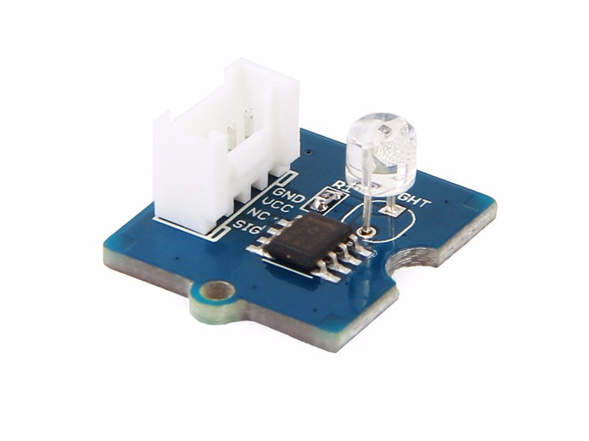
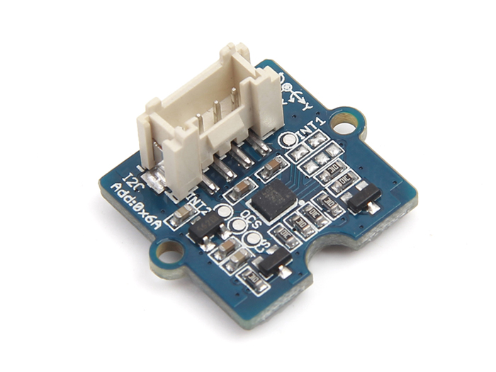
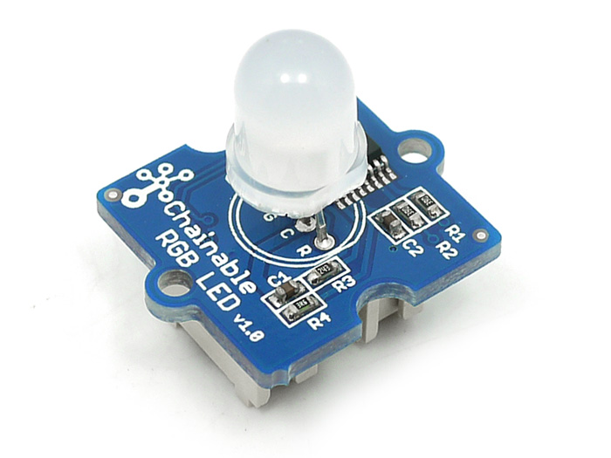
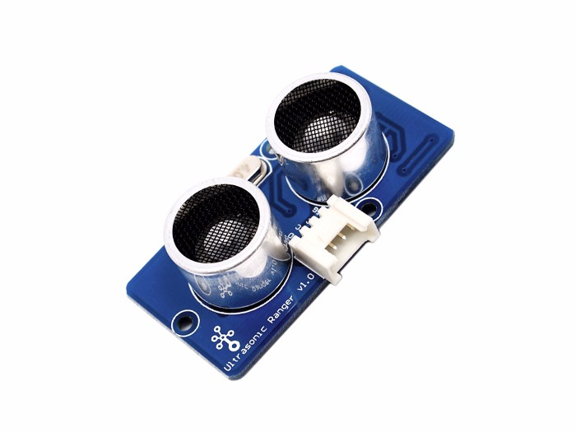
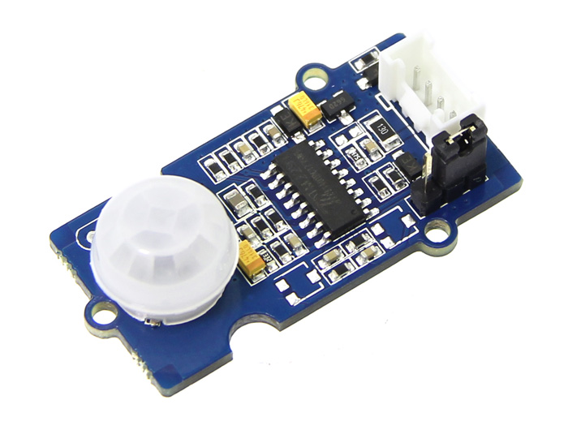
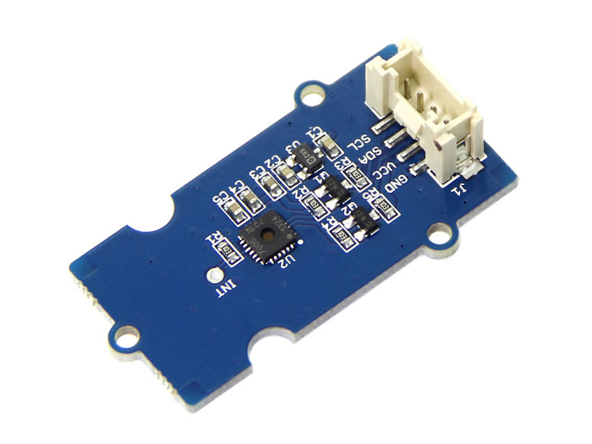
PYNQ Peripherals (2 of 4)
Light Sensor
6-Axis Accelerometer & Gyroscope
Chainable RGB LED
Ultrasonic Ranger
Temperature & Humidity Sensor
PIR Motion Sensor

Slide 27
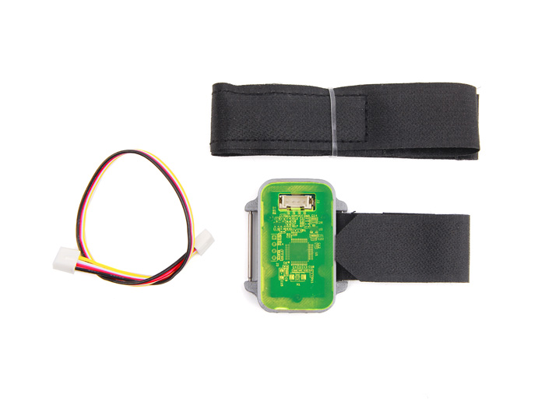
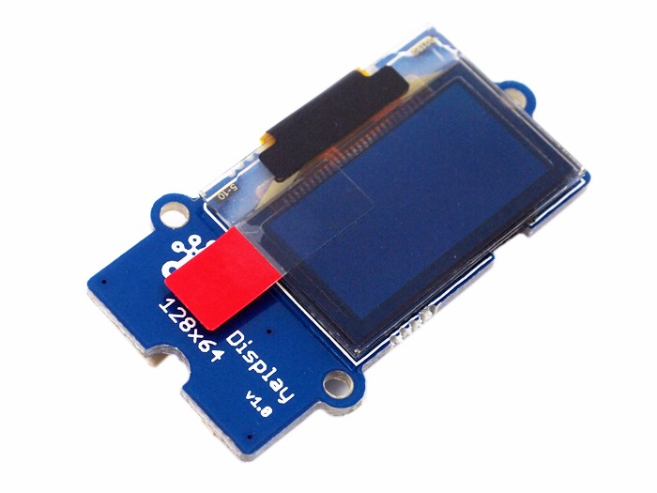
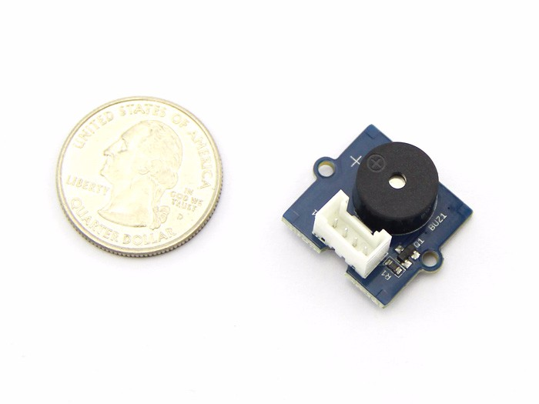
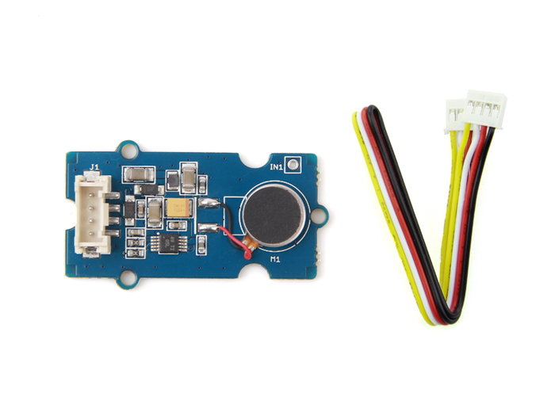
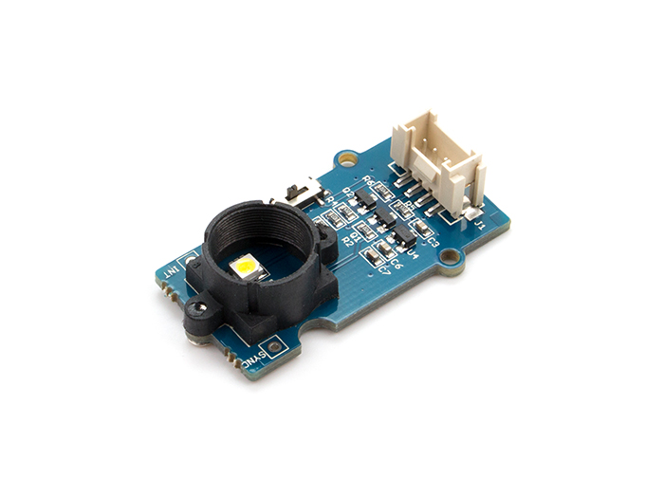
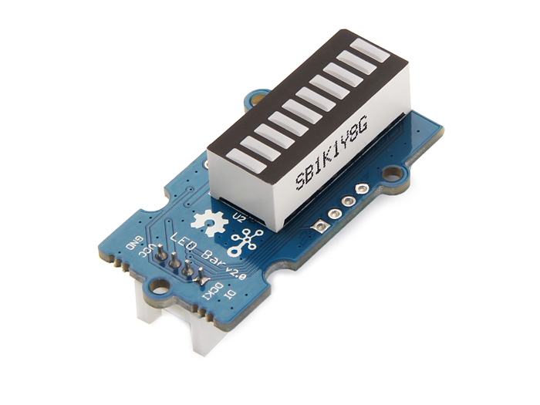
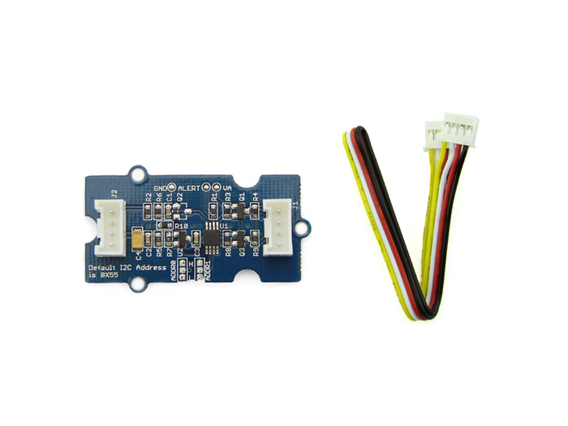
PYNQ Peripherals (3 of 4)
Heart Rate Monitor
OLED Display
Buzzer
Haptic Motor
Color Sensor
LED Bar
I2C Analog-Digital
Converter

Slide 28
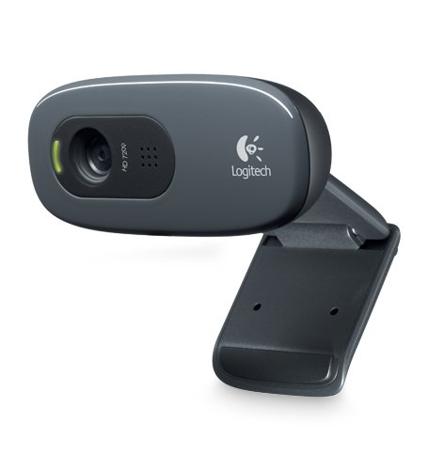
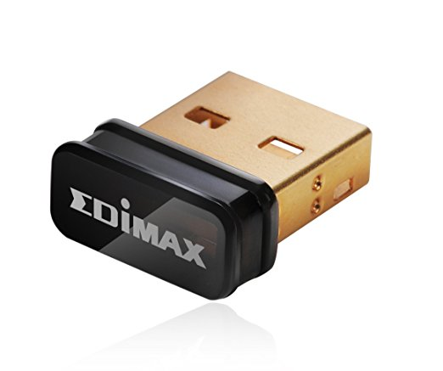
PYNQ Peripherals (4 of 4)
WiFi Dongle
720p USB Webcam
We’ll give some project ideas when we hand out boards

Slide 29
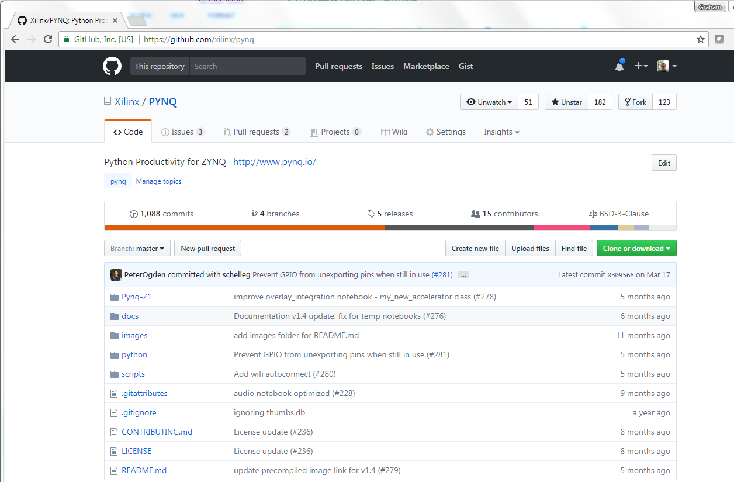
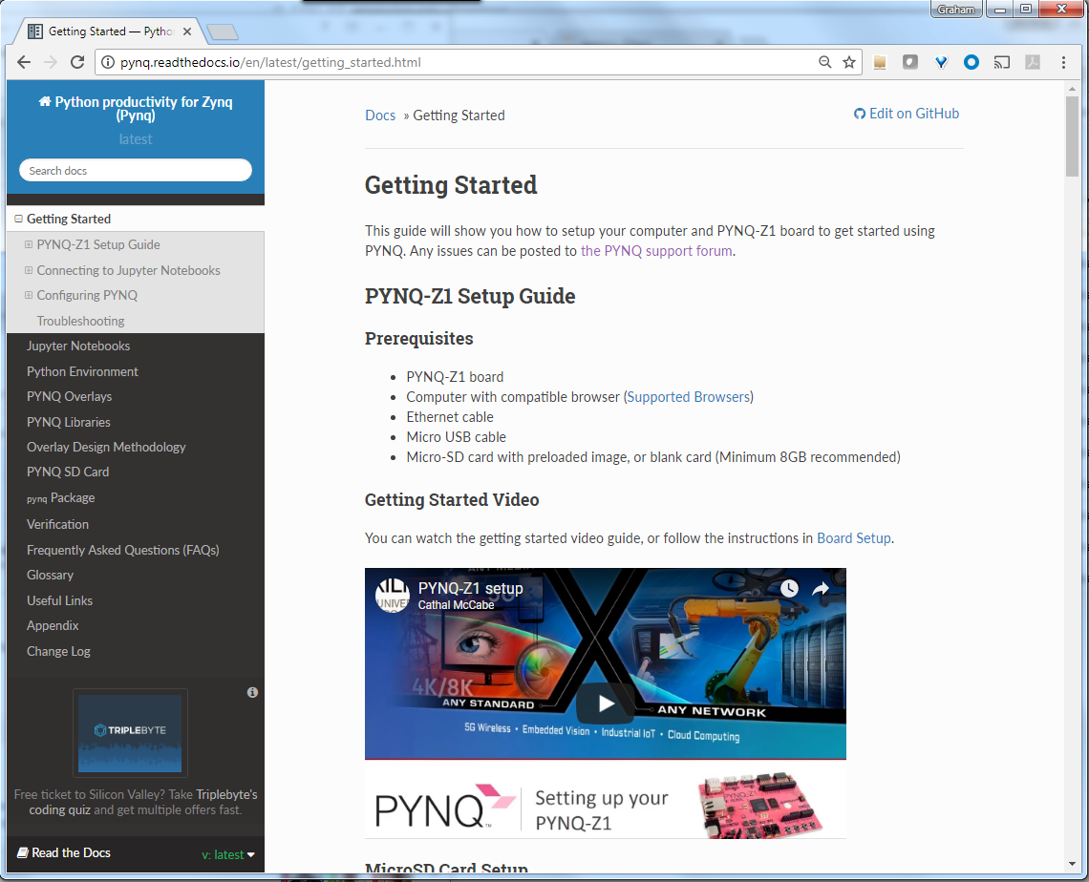
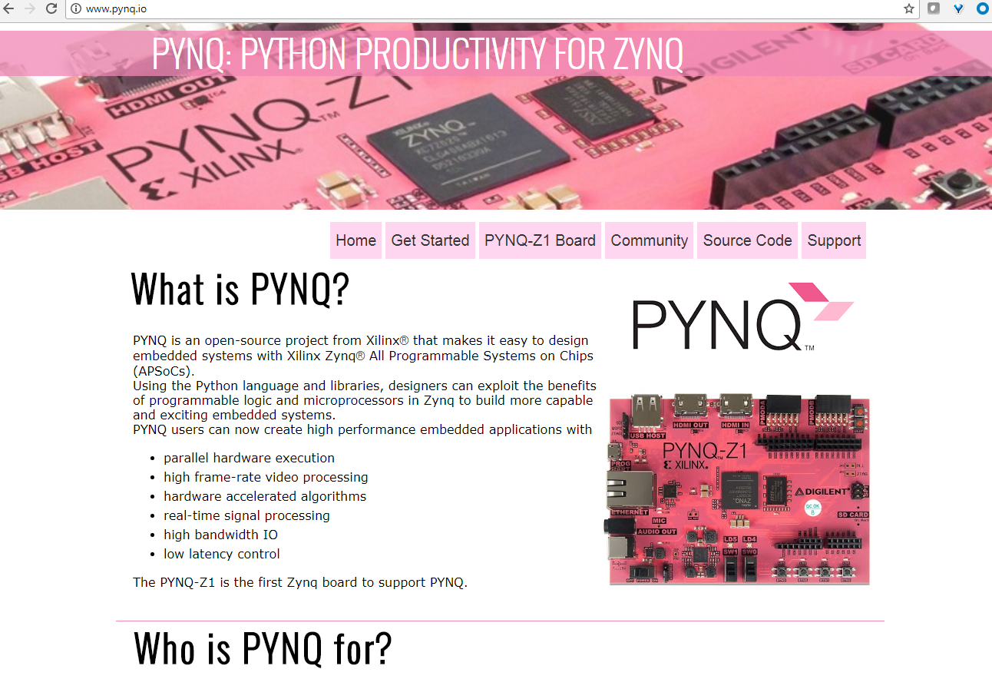
PYNQ is completely open-source
1. No Xilinx tools required to use PYNQ
2. At this hackathon, we’ll strive for open-*
-source, -projects, -solutions, -collaboration

Slide 30
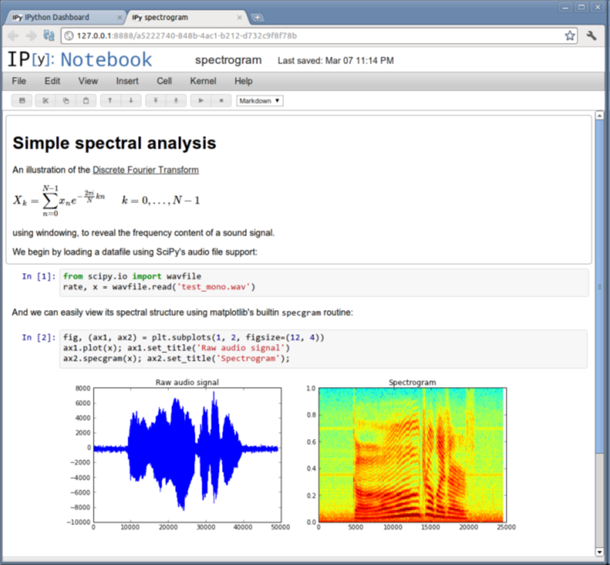
Notebooks: browser-based development … with rich, multi-media support
Designed for
Interactive, exploratory computing
Reproducible results
Ideal for
Teaching and learning
Projects and research
Rapid adoption
Across multiple disciplines
github.com/ipython/ipython/wiki/A-gallery-of-interesting-IPython-Notebooks
Part of a broader trend towards new, web-based IDEs

Slide 31

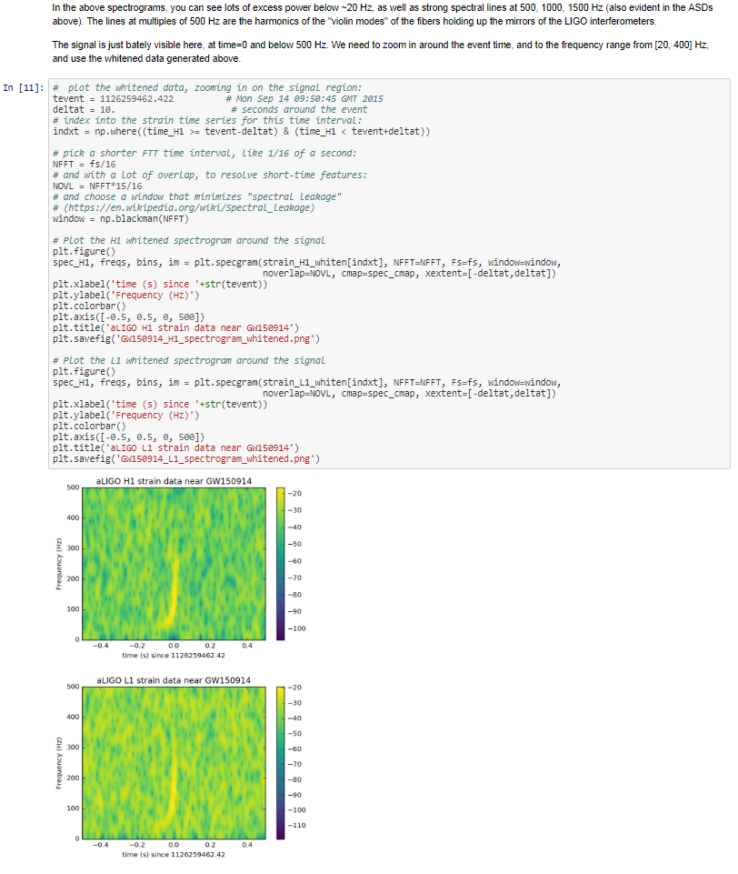


LIGO results shared as
Jupyter notebooks
https://losc.ligo.org/s/events/GW150914/GW150914_tutorial.html
Notes:
LIGO, which stands for the Laser Interferometer Gravitational-Wave Observatory, is a large-scale physics experiment aiming to directly detect gravitational waves.

Slide 32
Logistics
Hackathon Theme & Goals
Community Projects
Head back up to Retreat!
Welcome and
Orientation

Slide 33


Hackathons and Usergroups
Polytechnic University of Milan
100+ student hackathon
Tokyo User Group
75+ industry participants

Slide 34







FINN: Binary Neural Network Overlay on PYNQ
SVHN,
Road signs,
CIFAR-10
Image pre-processing in Python
Int. Symposium on FPGAs, Feb. 2017
Unprecedented image classification rates
1,000x speed-up over Raspberry Pi3
Binary Neural Network in FPGA & ARM CPU
“cat”

Slide 35




Machine Learning on PYNQ cluster
Best student paper award, MODCAST 2017
SPYNQ: Spark PYNQ cluster
https://www.youtube.com/watch?v=ix1NI7yq8O4

Slide 36



Evaluating PYNQ for image processing
Best short paper award, FCCM 2017
“The results are highly promising , with the ability to match and exceed performances from C implementations, up to 30x speedup.”

Slide 37



“PYNQ is a game-changer”
Partially reconfigurable video overlay
FPL2017
“After teaching students how to use FPGA-based systems for over 20 years, this is the first time we simply handed the boards to the students and all of them were able to use and/or add functionality to the system with no supervision.”

Slide 38

“A high productivity tool for experienced FPGA designers”
http://fpga.org/2017/09/05/pynq-as-a-high-productivity-platform-for-fpga-design-and-exploration
“Fellow FPGA designers, try Pynq. You’ll like it.
Pynq makes exploring new FPGA ideas lightweight, fresh, fast, easy, fun again..”
Pynq as a High Productivity Platform for FPGA Design & Exploration
“I hadn’t expected that Pynq would also be a high productivity tool for experienced FPGA designers to more rapidly explore, evaluate, discover, and play. Using Pynq to explore, develop, prototype saved me weeks of effort. It was particularly good for interactively writing tests and exploring new hardware corner cases in Python with <1 second turnaround.”
Jan Gray … feedback on implementing 80 x 32-bit RISC cores on PYNQ-Z1

Slide 39

Selection of projects
and notebooks

Slide 40
Group Participation!
Please introduce yourself
Name
School / Company
Interests
Do you need a team?

Slide 41
Logistics
Hackathon Theme & Goals
Community Projects
Head back up to Retreat!
Welcome and
Orientation

